Slide 1
Practical Propagation
Or
Propagation for dummies
Don KI5AIU

Slide 2
What is Propagation?
Radio propagation is the behavior of radio waves as they travel, or are propagated, from one point to another in vacuum, or into various parts of the atmosphere.^{[1]: 26‑1} As a form of electromagnetic radiation, like light waves, radio waves are affected by the phenomena of reflection, refraction, diffraction, absorption, polarization, and scattering.^{[2]} Understanding the effects of varying conditions on radio propagation has many practical applications, from choosing frequencies for amateur radio communications, international shortwave broadcasters, to designing reliable mobile telephone systems, to radio navigation, to operation of radar systems.

Slide 3
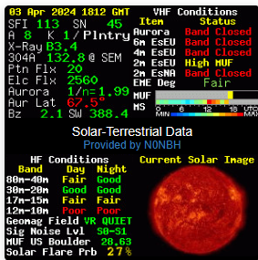
Traditional Propagation
https://www.hamqsl.com/solar.html
Not going to discuss it.
Dave N7RF is an expert on this.

Slide 4
Practical Propagation
Using existing tools to see what paths are available and who can hear us.
VOACAP
DXMaps
Reverse Beacon Networks
PSKReporter

Slide 5
VOACAP
https://www.voacap.com/hf/
Voice of America Coverage Analysis Program VOACAP
VOACAP is free professional high-frequency (3-30 MHz) propagation prediction software from NTIA/ITS, originally developed for Voice of America (VOA).

Slide 6
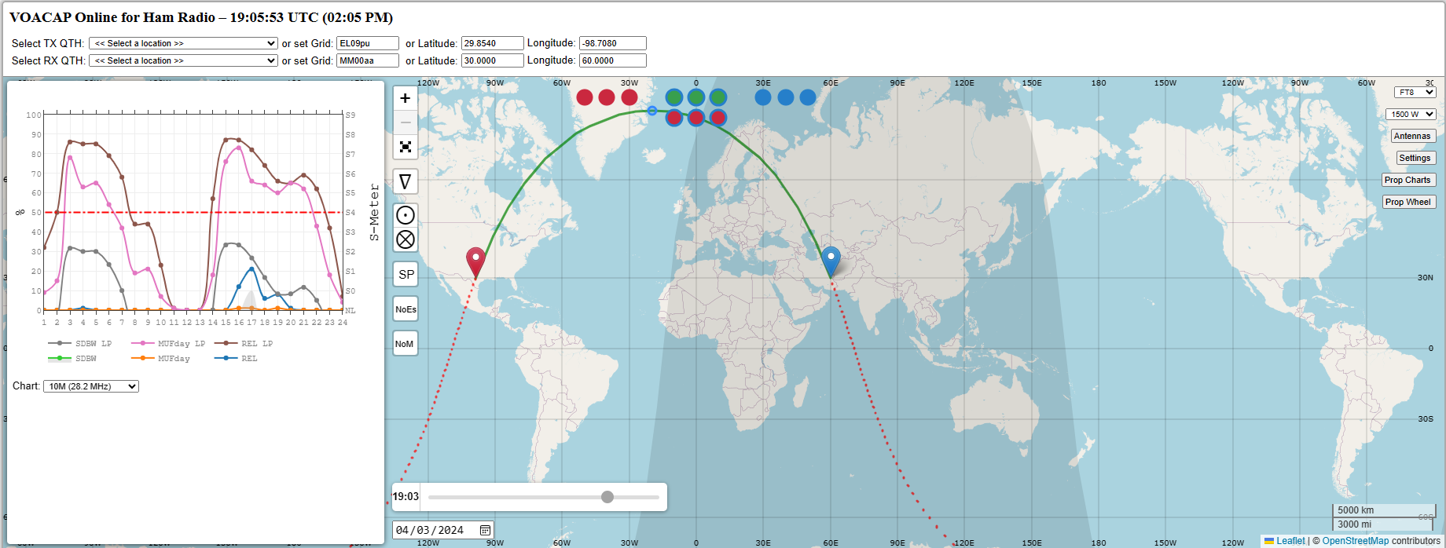
VOACAP

Slide 7
DXMaps
https://www.dxmaps.com/spots/mapg.php
DXMAPS.COM web site shows on maps or lists the most recent contacts and reception reports in the different amateur radio and SWL bands. Its aim is to provide a detailed but comprehensive view of the propagation conditions in real time.

Slide 8
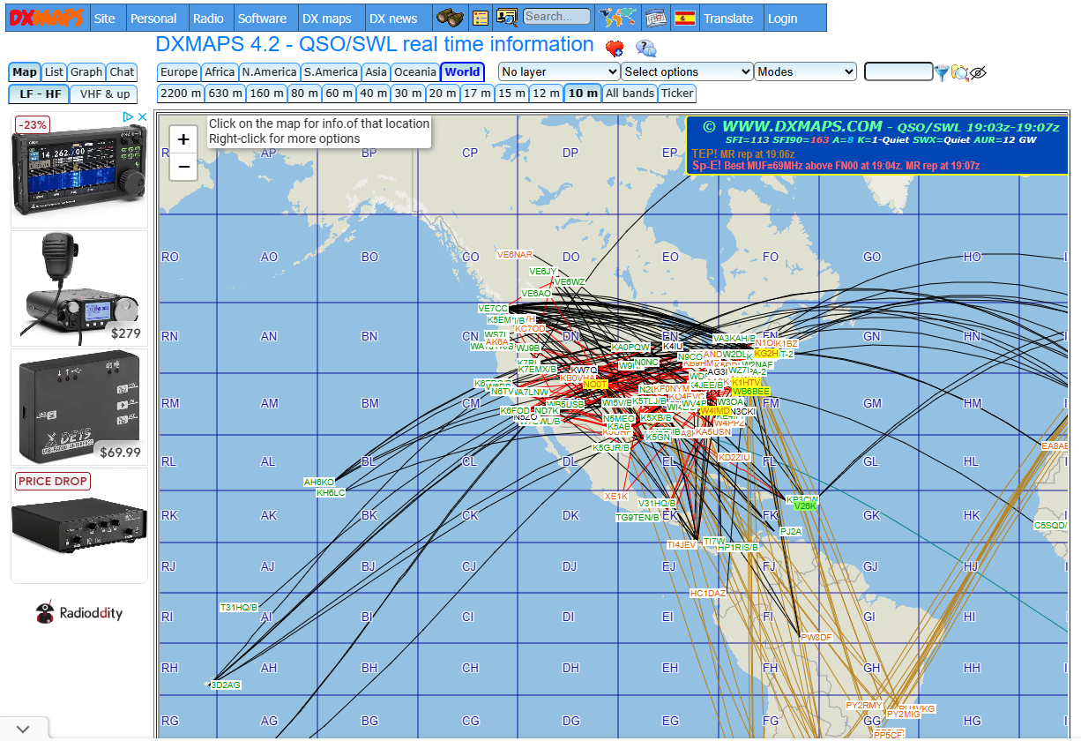
DXMaps

Slide 9
Reverse Beacon Network
https://www.reversebeacon.net/
CW Skimmer, software capable of decoding many CW signals at once, was released in early 2008. At the time, the author Alex, VE3NEA viewed it primarily as a DXing tool, permitting efficient monitoring of pileups. It’s no surprise that contesters soon saw how they could use it to increase their scores, and controversy quickly erupted as to whether contest rules should permit the use of skimmers. After Alex added telnet capability, potentially permitting a local skimmer to feed spots directly to contest logging software, the debate took over the CQ-Contest reflector. Was this “assistance”, like the DX cluster?

Slide 10
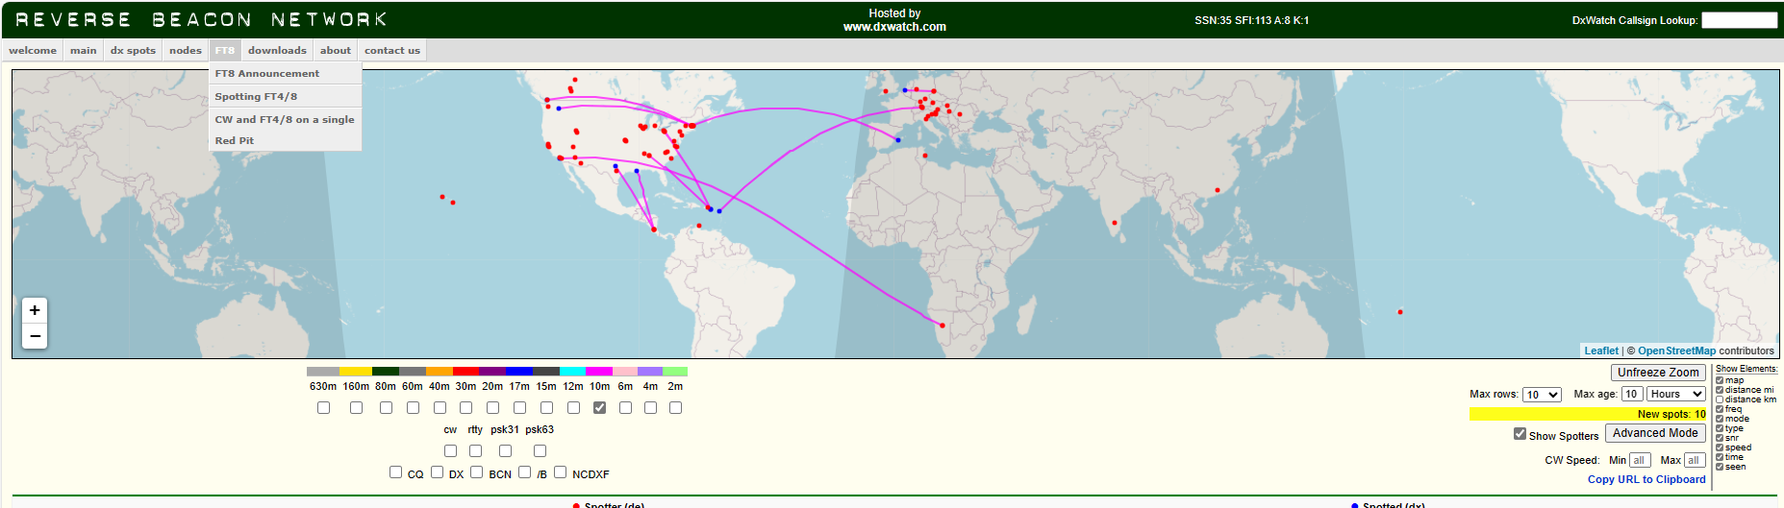
Reverse Beacon Network

Slide 11
PSKReporter
https://www.pskreporter.info/pskmap.html
Works for various modes
Gives information about the remote side
Near real-time (except during contests! )
Use it like a fish finder!

Slide 12
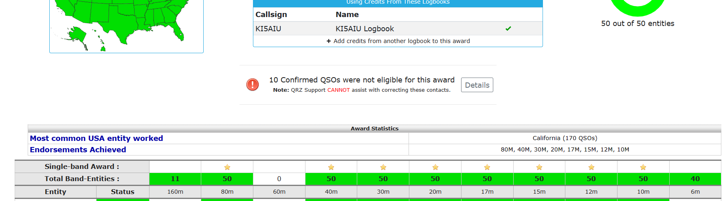
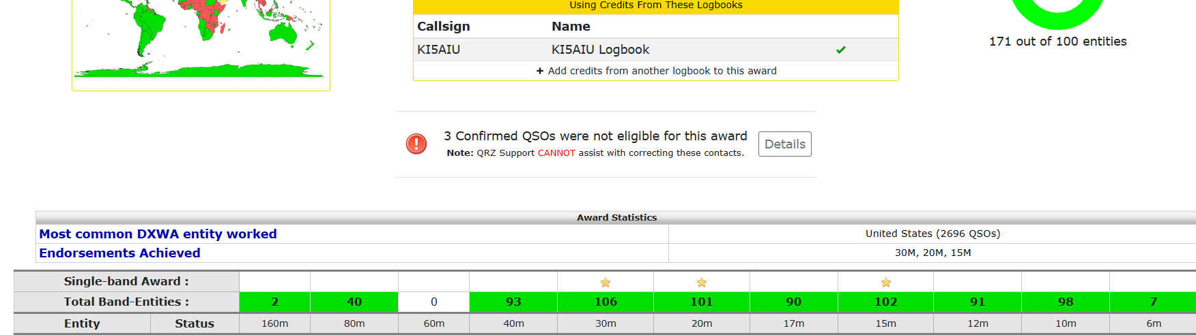
Does this work?
WAS
DXCC

Slide 13
Equipment
Started with Yaesu FT-991a and 40-10 End Fed.
Added HyGain 680 vertical antenna.
Upgraded to Yaesu FTdx101D (991a is backup and VHF/UHF).
Added Elecraft KPA500 amplifier.
All fits in a closet.
A good bit of WAS and DXCC was done on the FT-991a and the 40-10 End Fed.

Slide 14
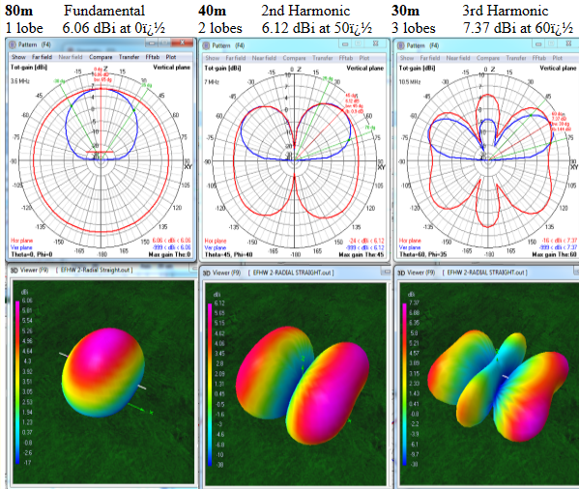
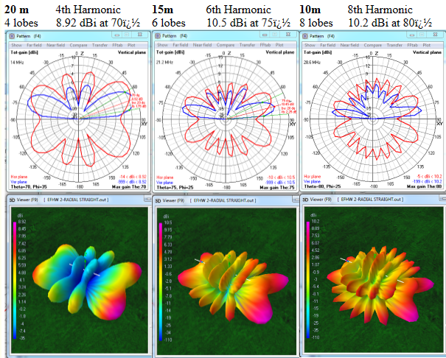
Let’s start!
Know your antenna
Vertical – Omni directional; but low takeoff angle
End fed – S0mewhat directional, depending on the band, know the lobes for a particular band.

Slide 15
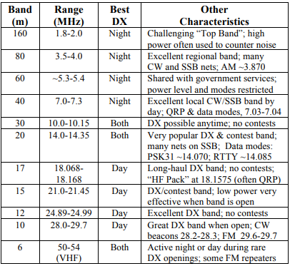
Which band? And more importantly, when?

Slide 16
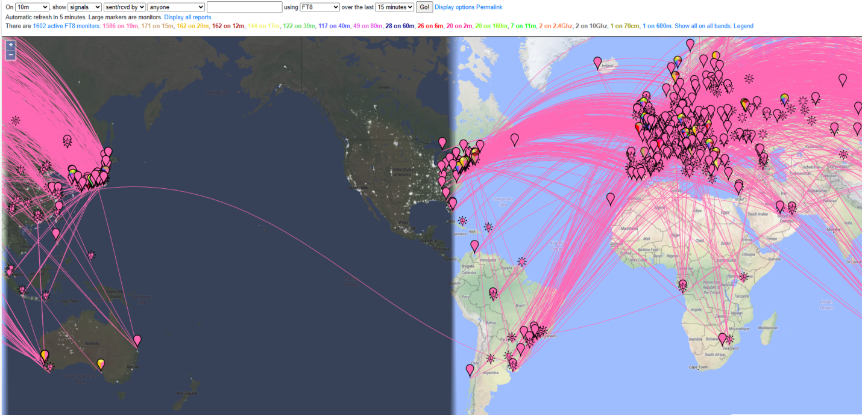
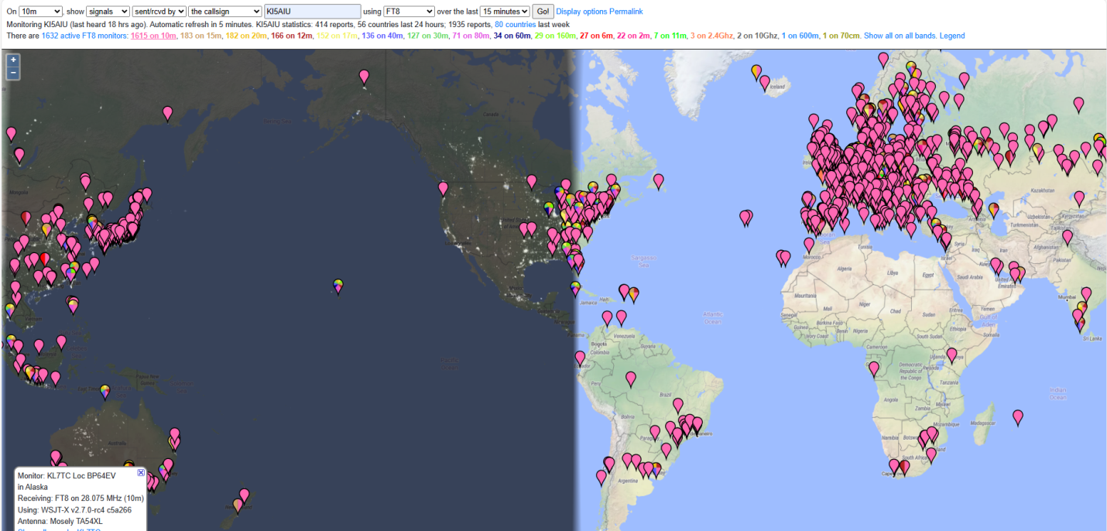
10 Meters
SFI 169 @ 6:26am
Calling CQ @50W on Vertical.

Slide 17
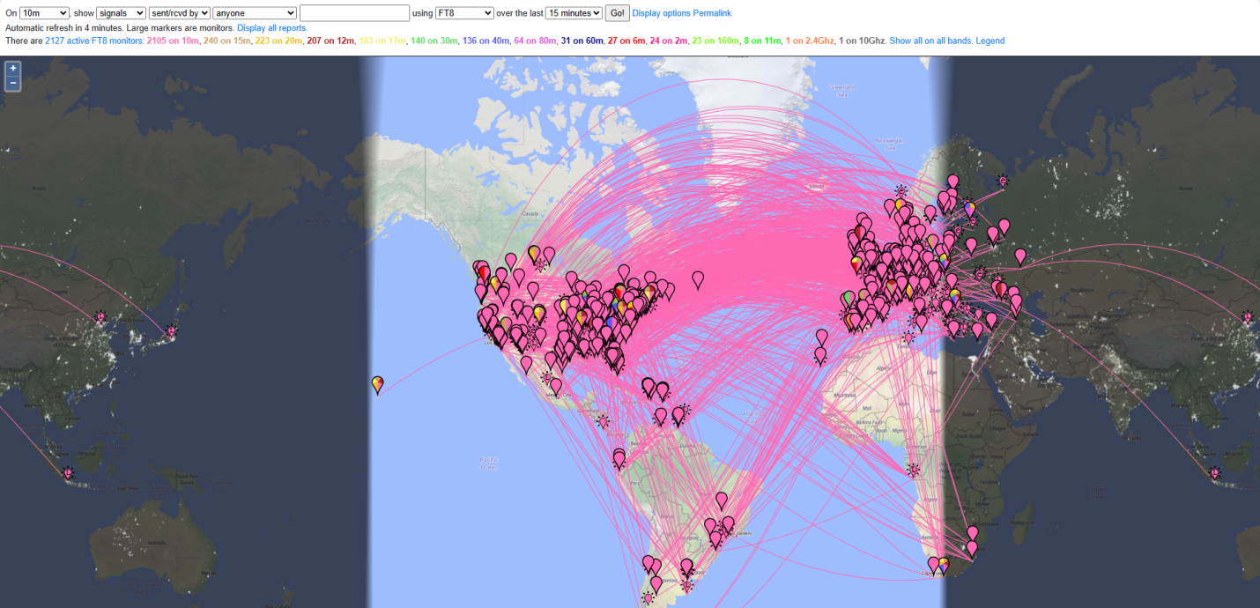
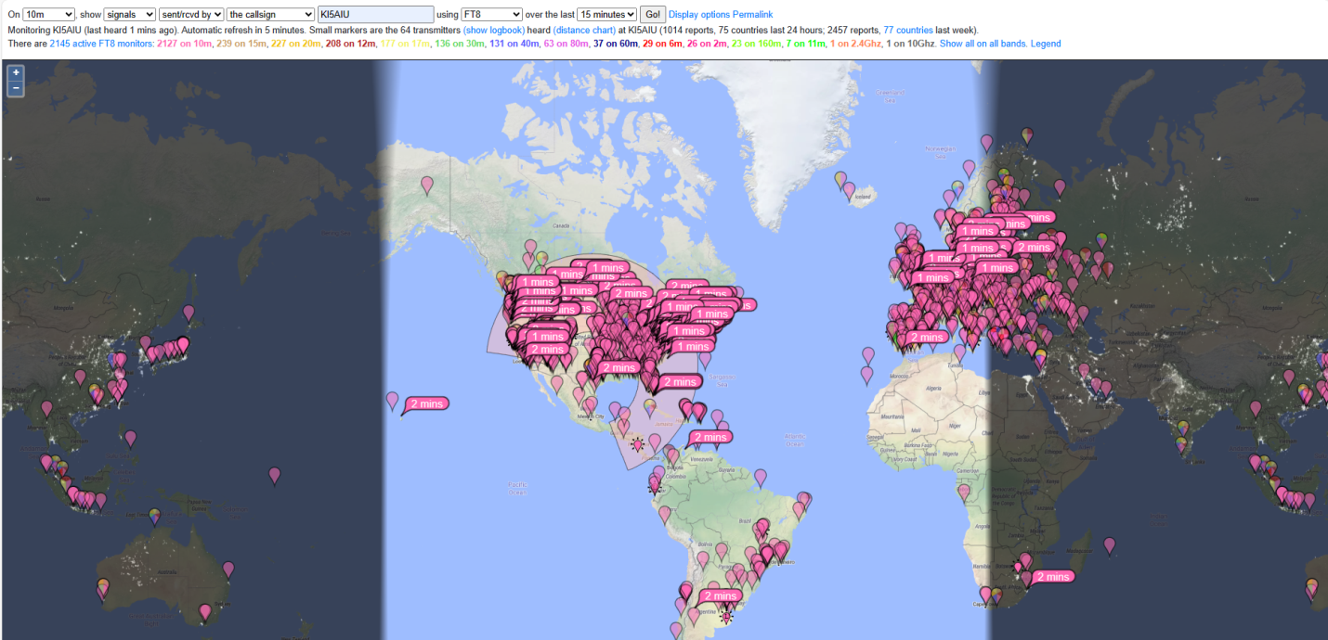
10 Meters
SFI 177 @ 11:39am
Calling CQ @50W on Vertical.

Slide 18
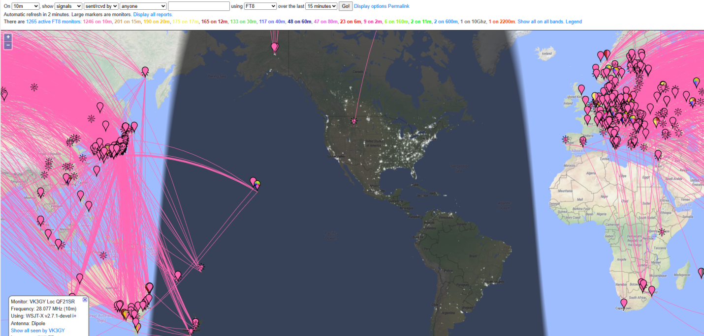
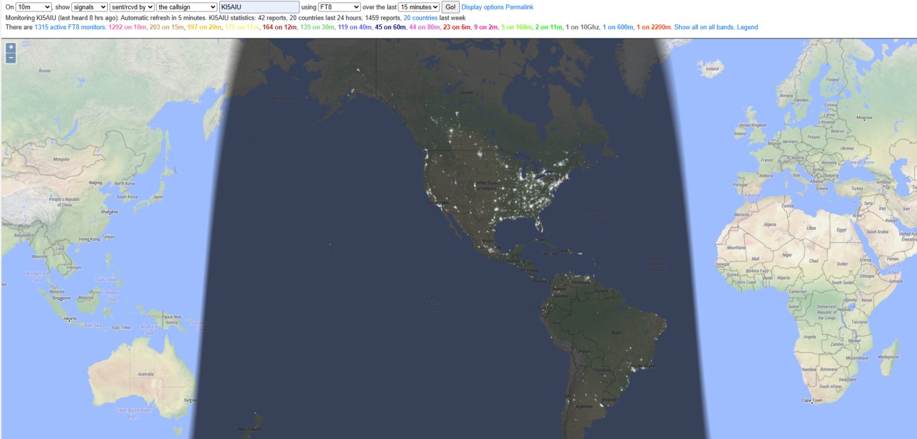
10 Meters
SFI 140 @ 02:29 am
Calling CQ @50W on Vertical.

Slide 19
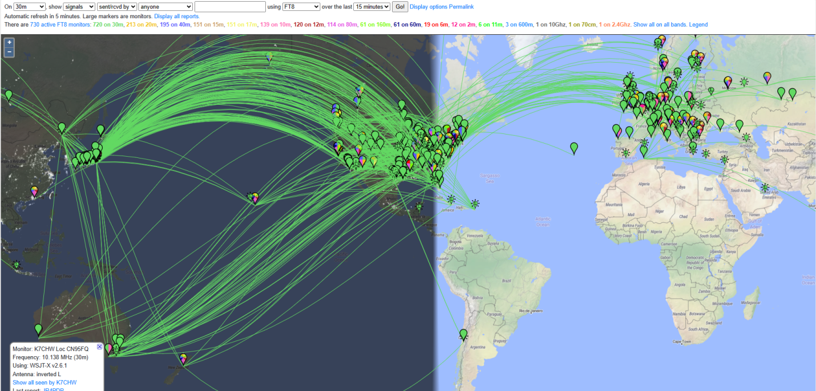
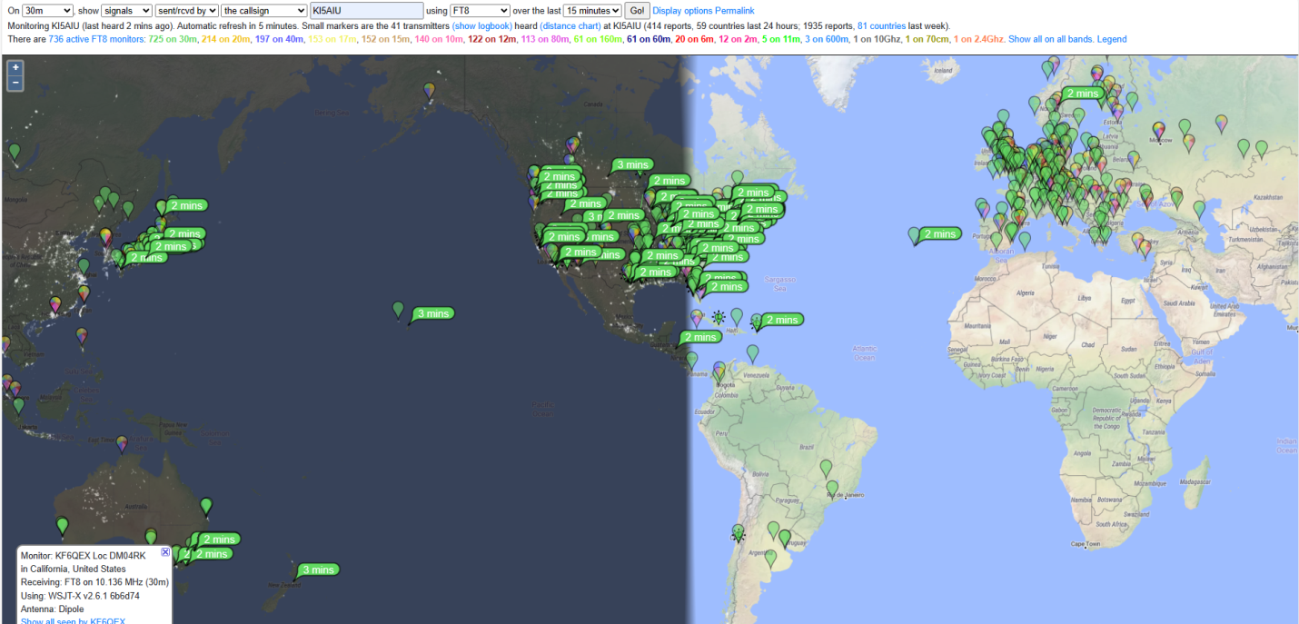
30 Meters
SFI 169 @ 06:33 am
Calling CQ @50W on Vertical.

Slide 20
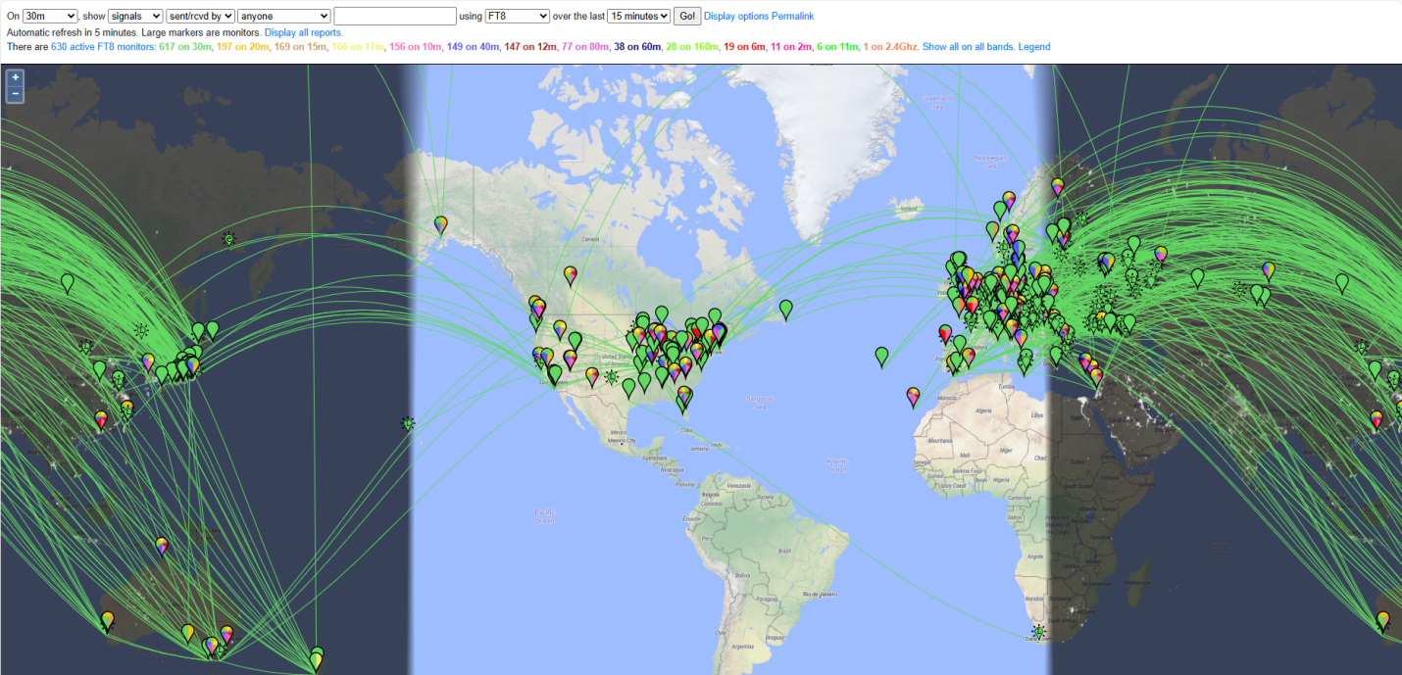
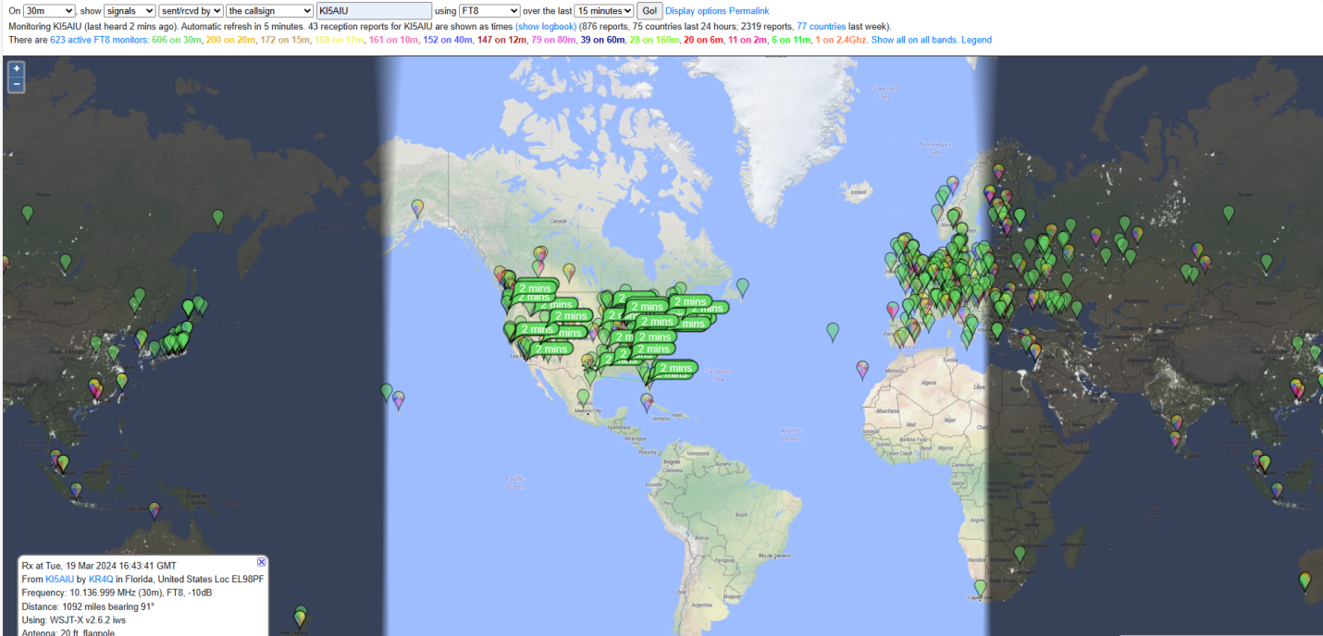
30 Meters
SFI 177 @ 11:40 am
Calling CQ @50W on Vertical.

Slide 21
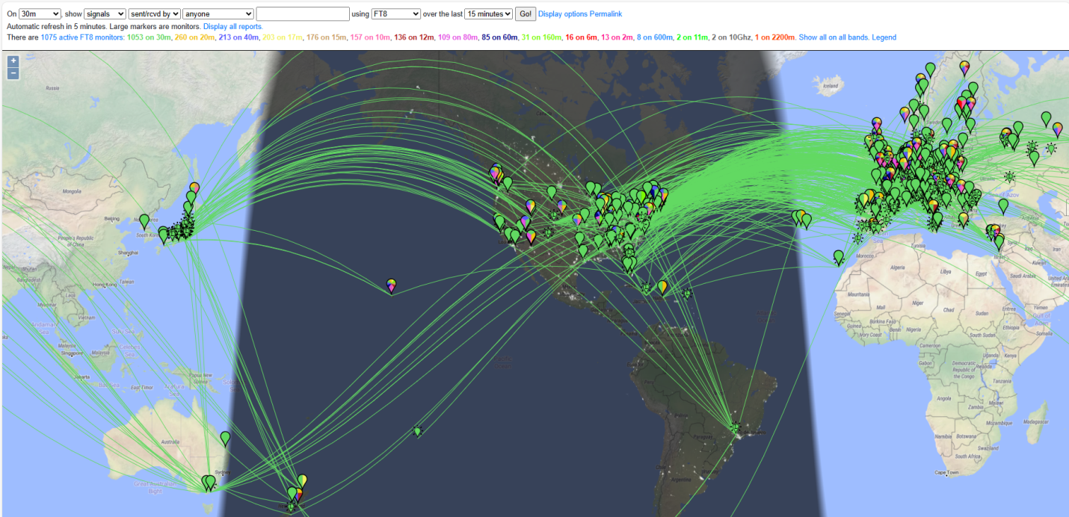
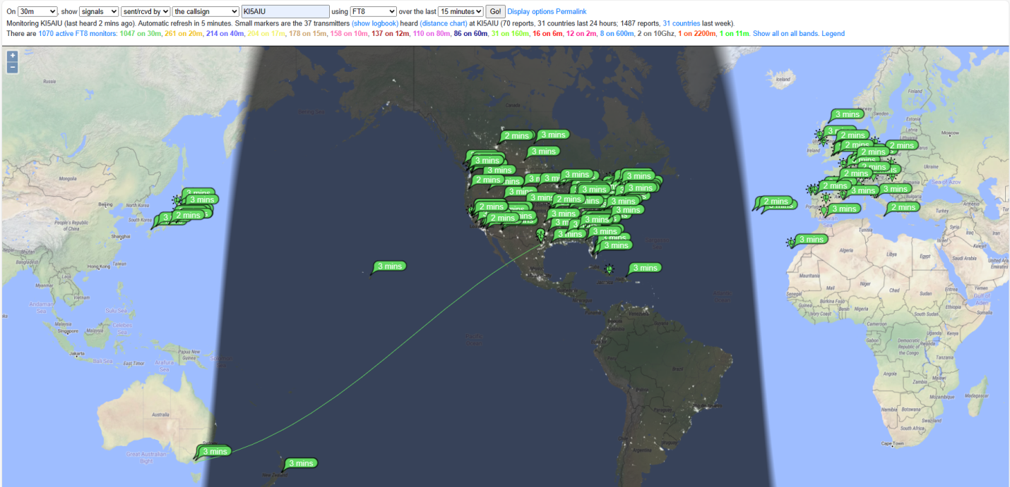
30 Meters
SFI 140 @ 02:39 am.
Calling CQ @50W on Vertical.

Slide 22
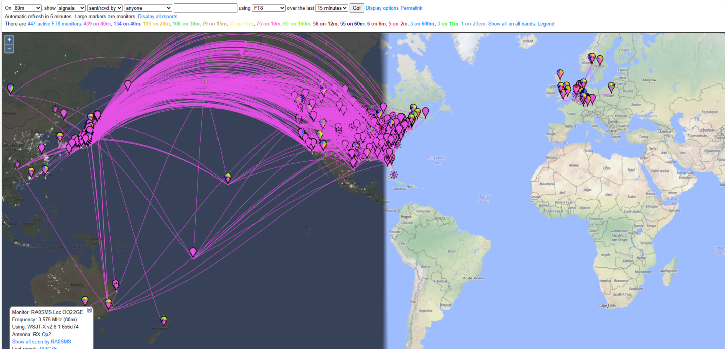
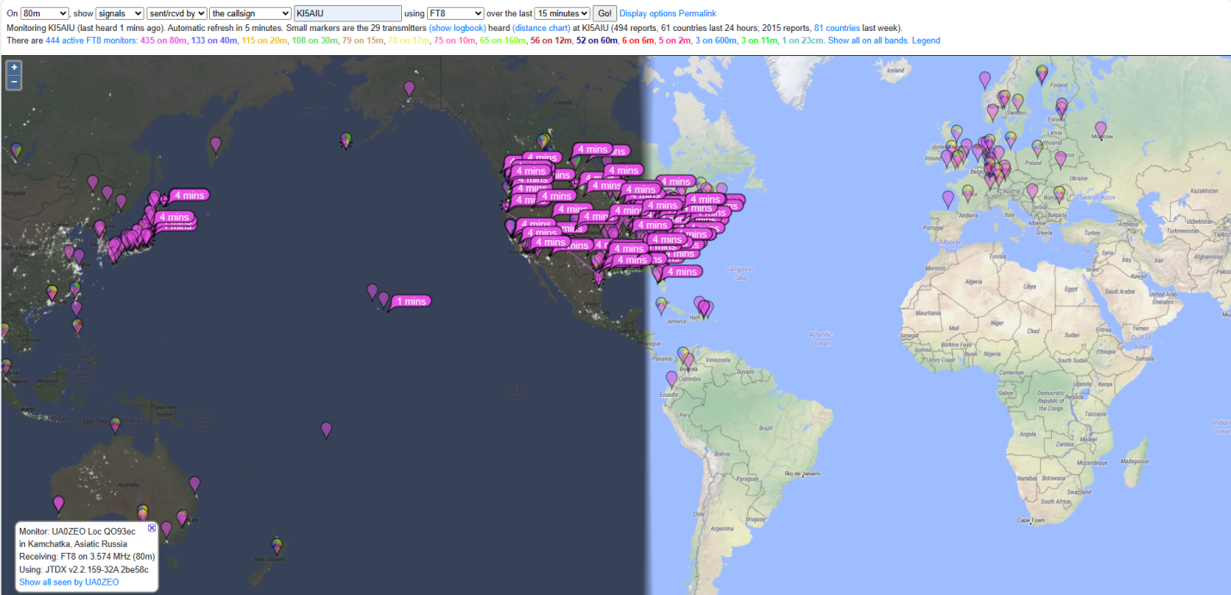
80 Meters
SFI 169 @ 06:41 am.
Calling CQ @50W on Vertical.

Slide 23
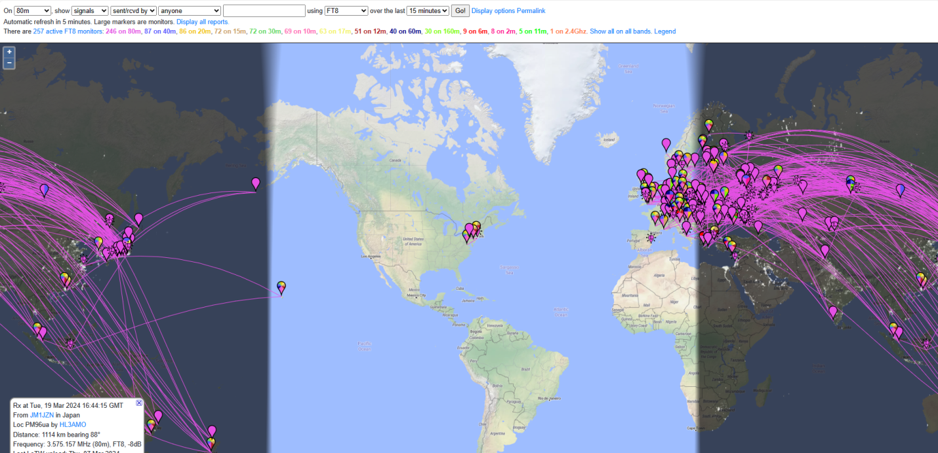
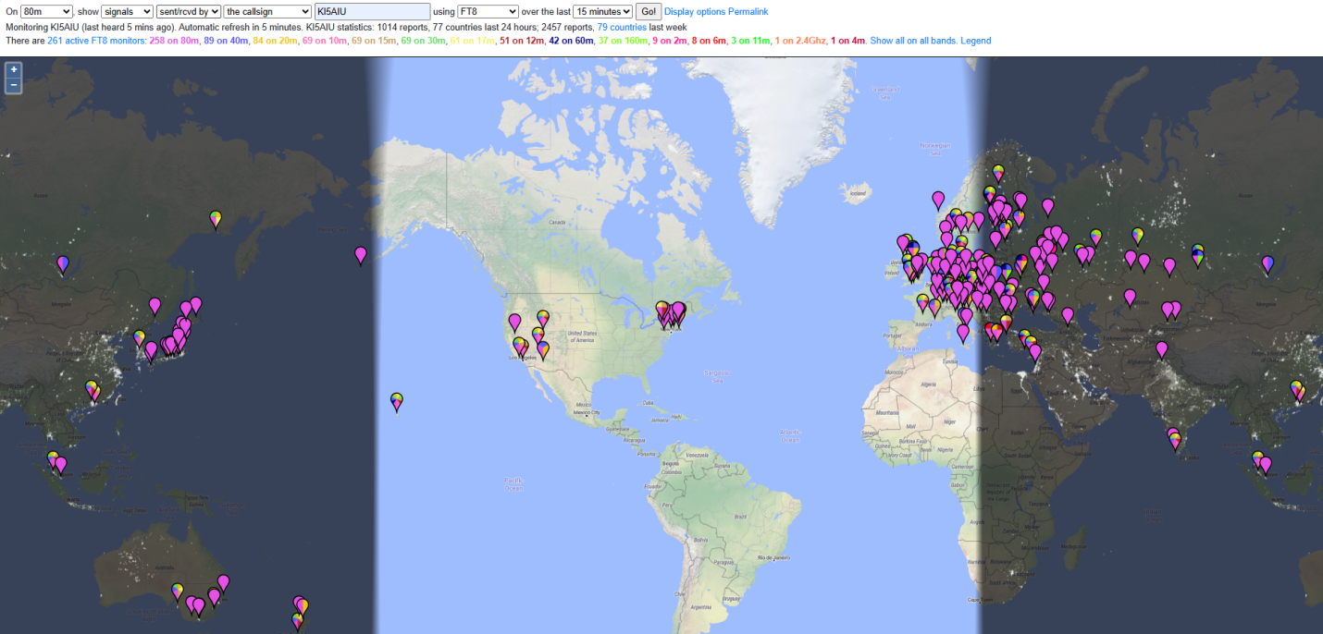
80 Meters
SFI 177 @ 11:50 am
Calling CQ @50W on Vertical.

Slide 24
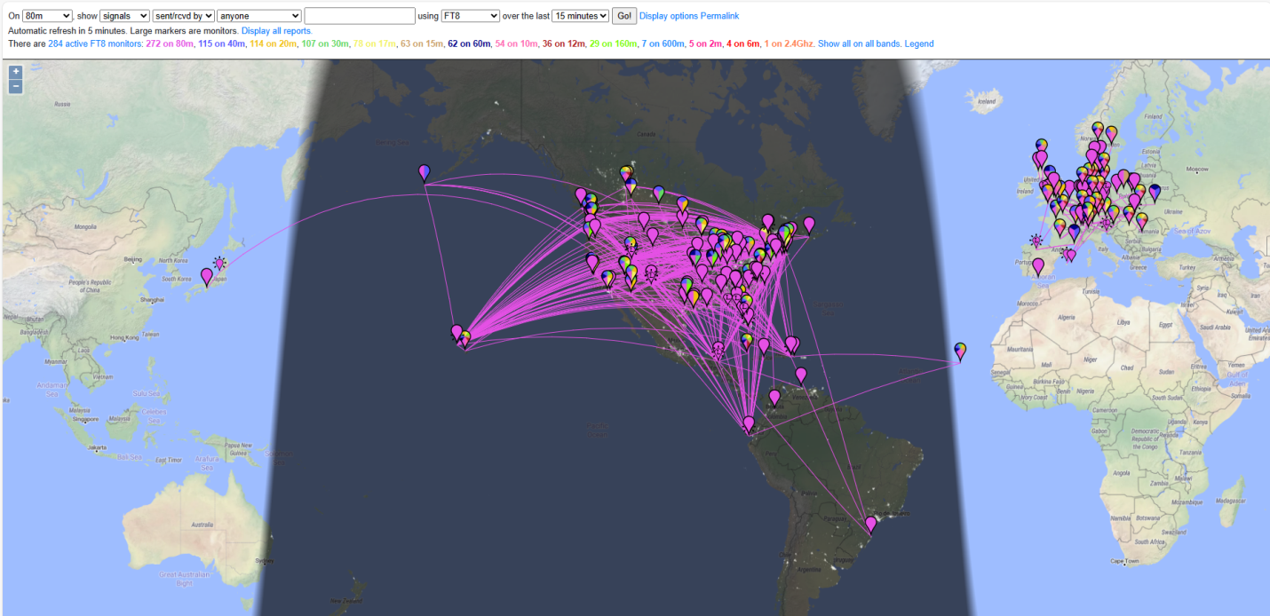
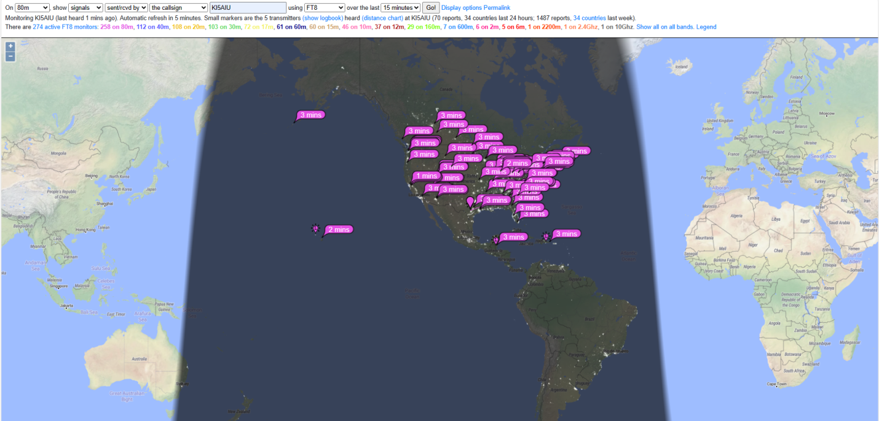
80 Meters
SFI 140 @ 02:49 am
Calling CQ @50W on Vertical.

Slide 25
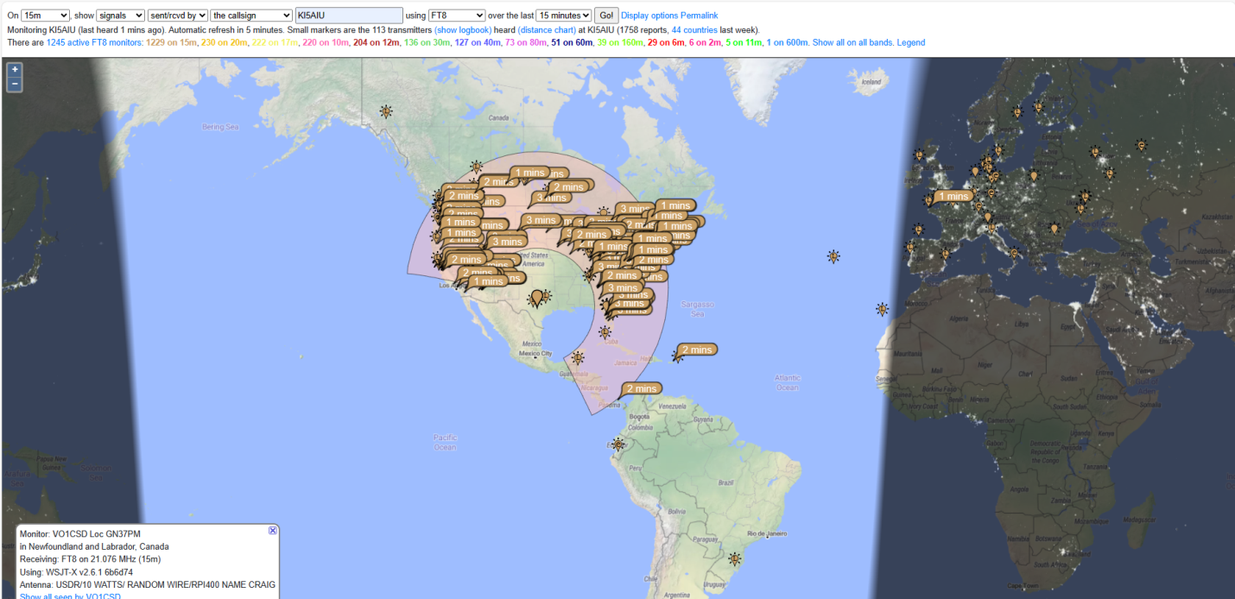
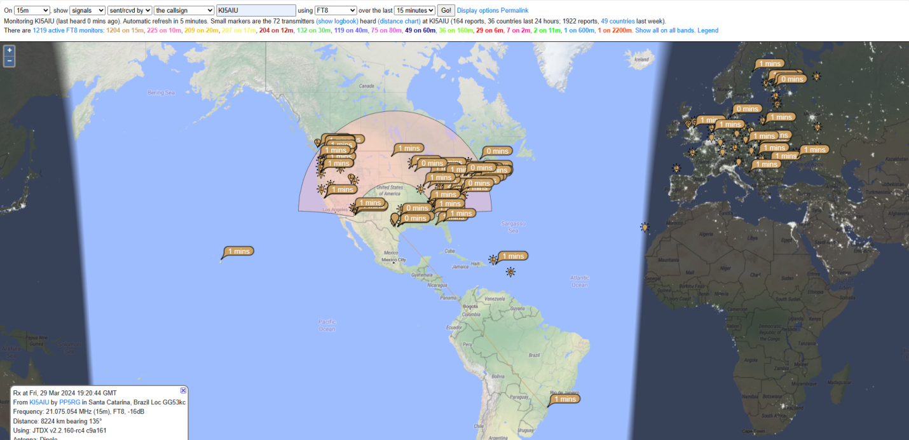
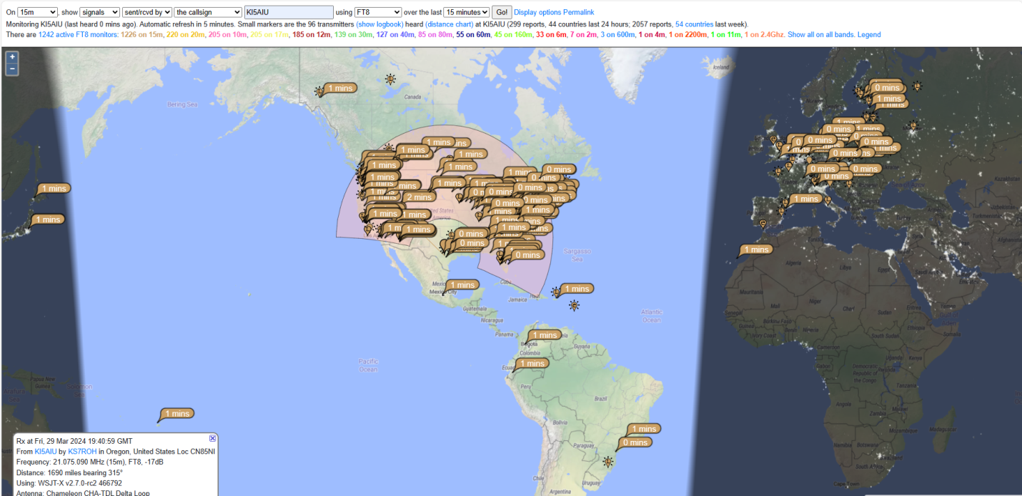
Power?
SFI @173 on 15M
1. KX3 @ 10W via Vertical 2:00 pm
2. FTdx101D @50w via Vertical 2:20 pm
3. FTdx101D @200w via Vertical 2:40 pm

Slide 26
Questions?

