Slide 1

Advanced WSJTX, JTAlert, GridTracker Setup
Jesse Jarrell - W1BBT
August 1, 2024

Slide 2

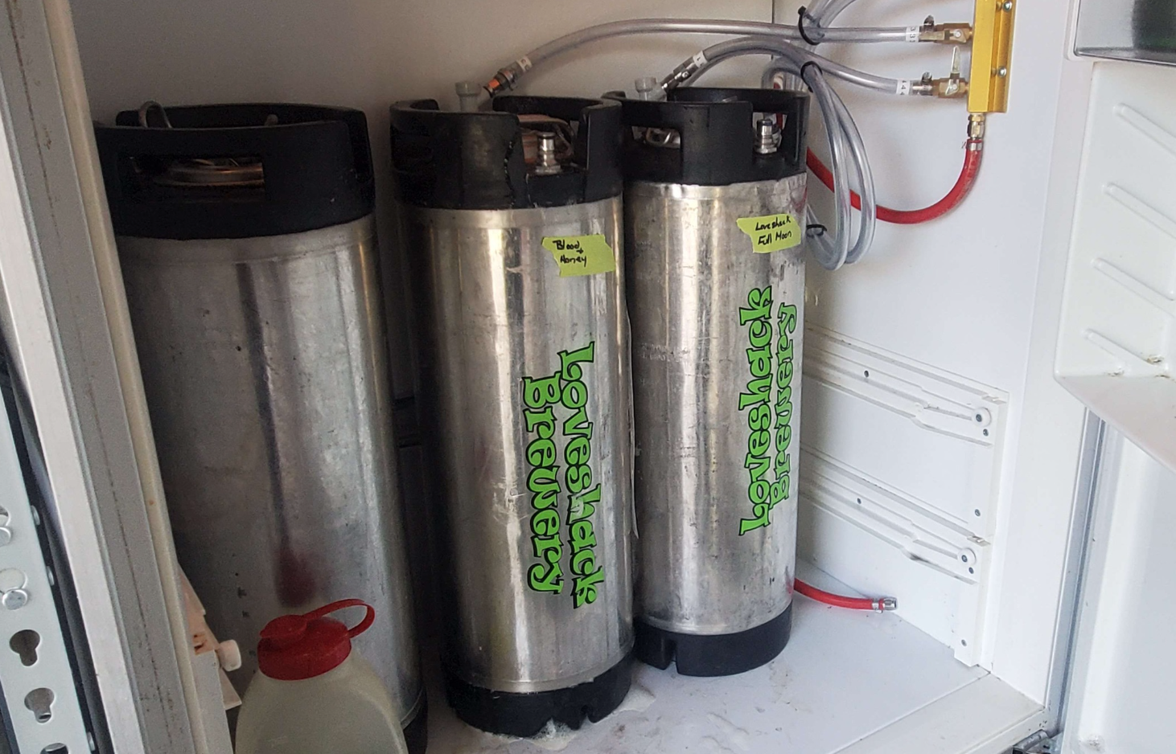
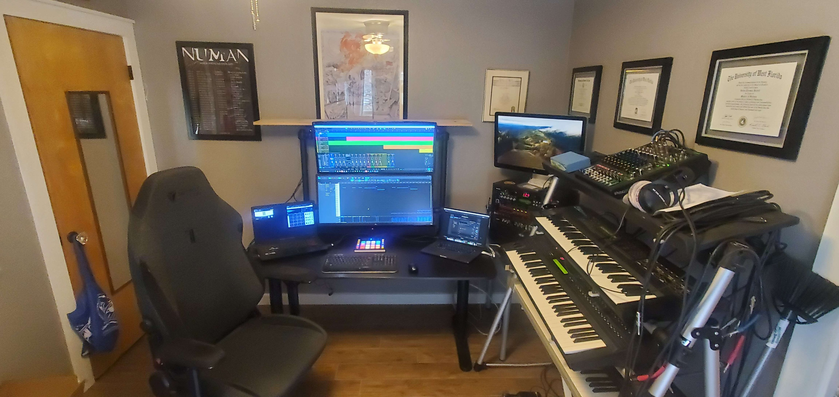

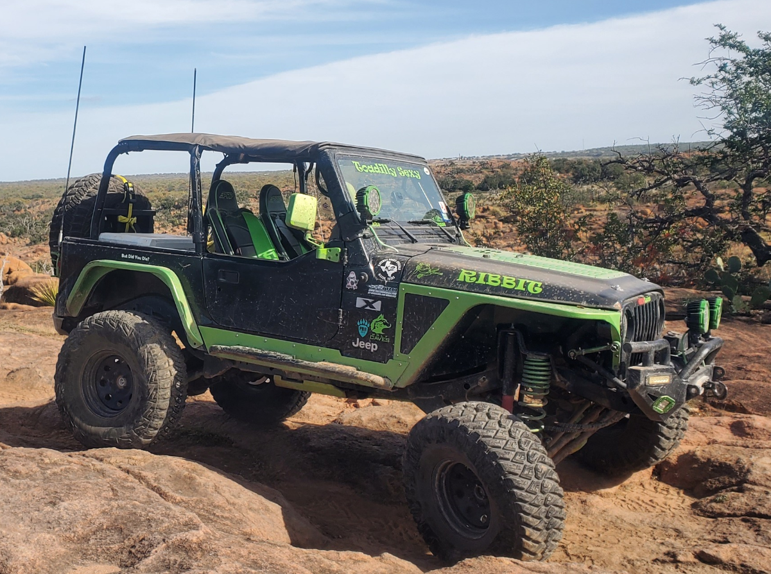
Who is this guy?
Callsign: W1BBT
Ham Since: 11/19/2019
License: General (May 2023)
KARS Secretary 2024-2025
Professional Experience:
Software Engineer - 40 years
Employer:
Accenture Federal Services
Hobbies:
Recording Artist, Rock Crawling, Homebrewing, Bourbon, Ham Radio, Breaking things that are not supposed to be broken

Slide 3
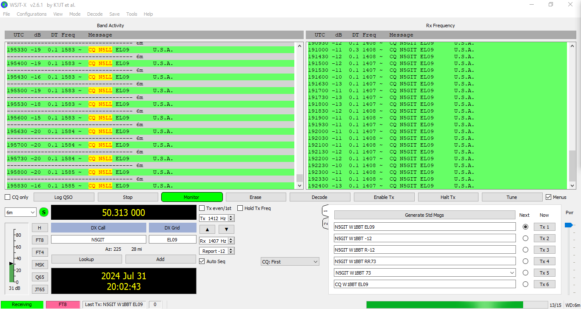
Why are we here?
Expanding the usability of WSJTX by integrating JTAlert and GridTracker
Using JTAlert to sift through the noise
Using GridTracker to find stations not actively calling CQ and to manage logging
Using multiple computers to offload tasks

Slide 4

Why are we not here?
Configuring your radio for FT8
Configuring WSJTX to work with your radio
If this makes you a sad panda, I’m sorry. :(

Slide 5
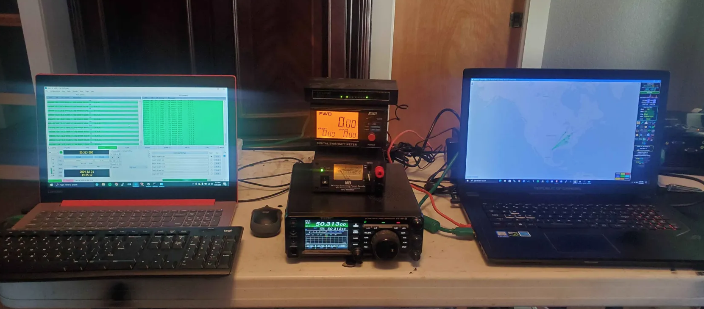
Equipment
Radio Equipment
  Yaesu 991A
  MFJ 4230MVP Power Supply
  Nissei DG503 SWR/Watt Meter
Laptop A
  Lenovo 2.2ghz i3 Intel w/12gb RAM
  Windows 10
  WSJTX
  JTAlert
Laptop B
  Asus ROG i7 2.8ghz w/32gb RAM
  Windows 10
  Gridtracker

Slide 6
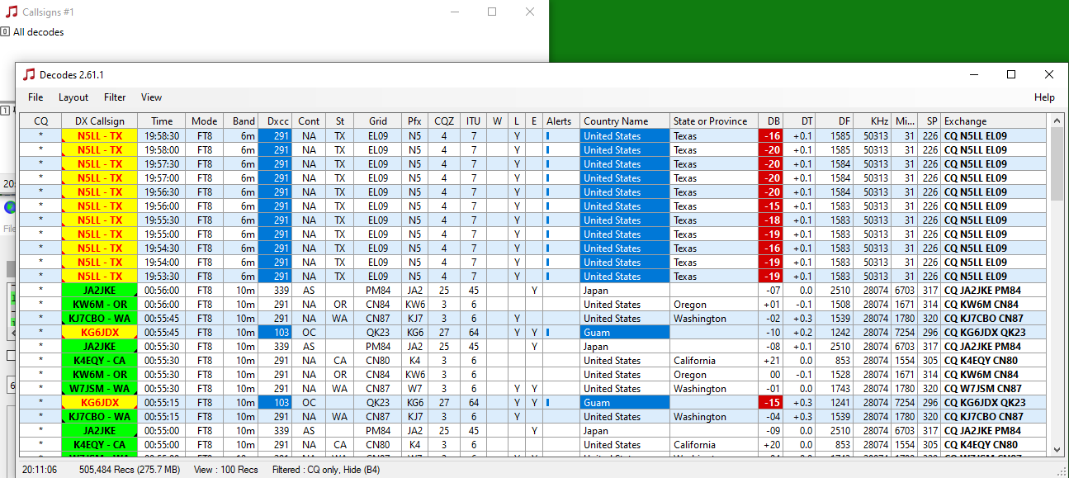
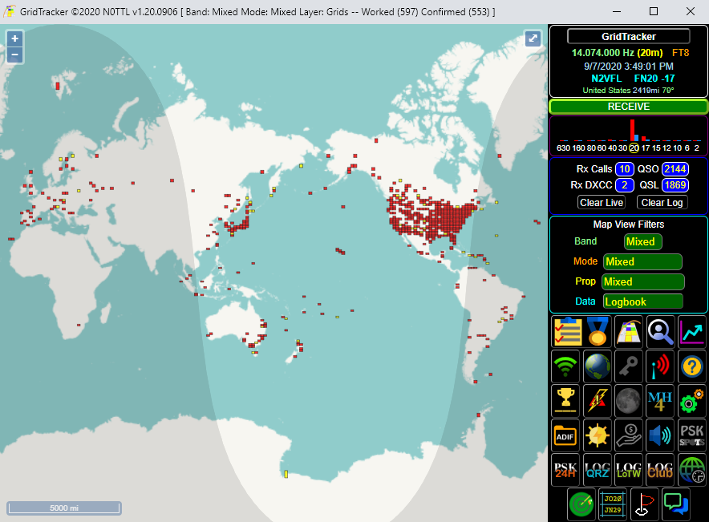
Software
WSJTX - https://wsjt.sourceforge.io/wsjtx.html
JTAlert - https://hamapps.com/
Gridtracker - https://gridtracker.org/
Notes:
We start with WSJTX, then we add JTAlert and Gridtracker.

Slide 7
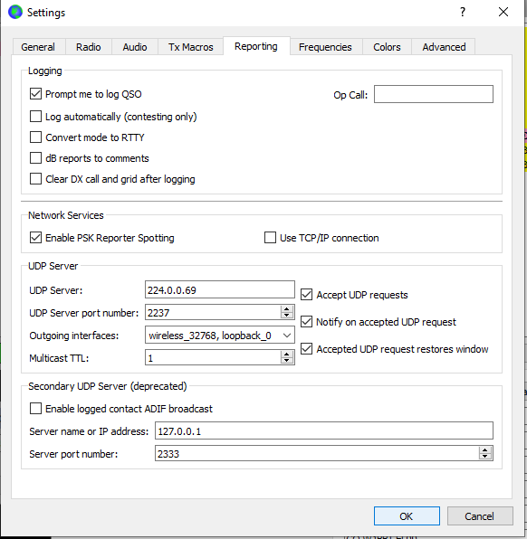
Make WSJTX Chatty
Prompt me to log QSO
Enable PSK Reporter Spotting
UDP Multicast Server
  Pick a UDP Multicast address (224.0.0.0 through 239.255.255.255)
  Pick a UDP Port (Default 2237)
  Choose outgoing interfaces
  Multicast TTL
Notes:
QSO should not be automatic - WSJTX gets it wrong sometimes.
Be kind and be a PSK Reporter since you’re going to be using PSK Report services
This is the magic sauce - UDP Multicast Server. This is what tells WSJTX to broadcast events via multicast UDP packets, and what allows JTAlert and Gridtracker to receive information on what WSJTX is doing. Keep the address/port simple - you will be using it elsewhere as part of their configurations

Slide 8
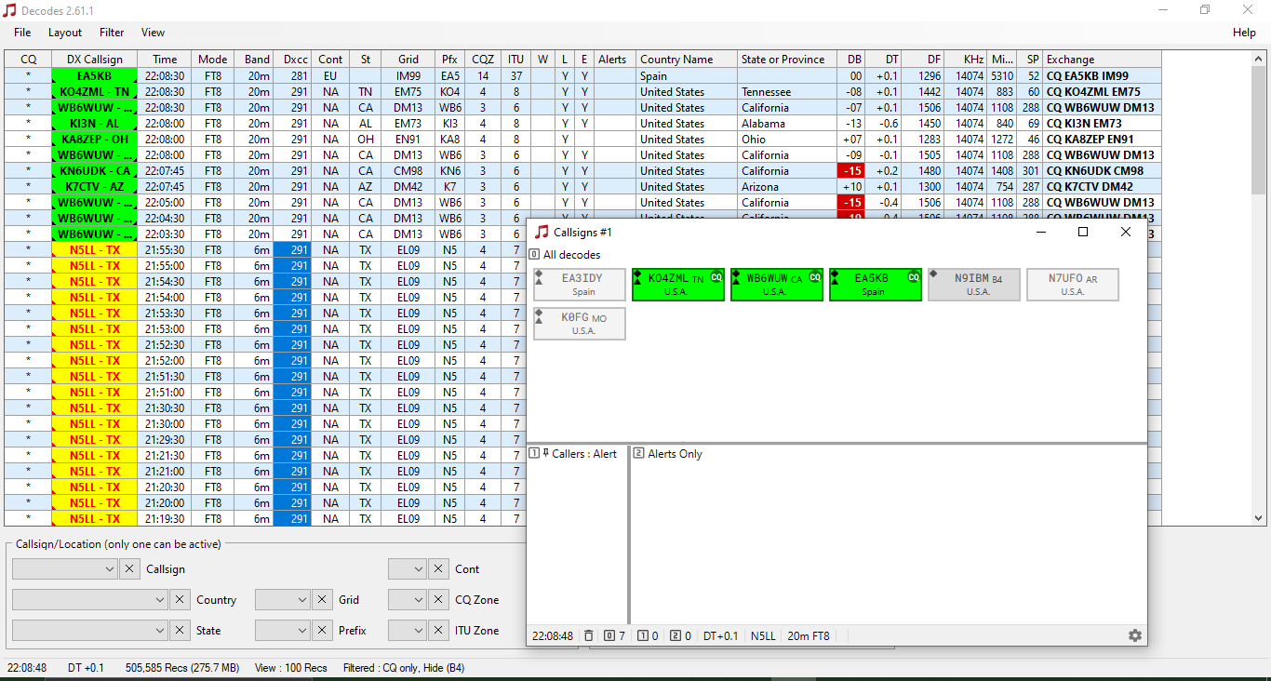
JTAlert
JTAlert organizes incoming decodes making it easy to
see what stations you have worked prior

Slide 9
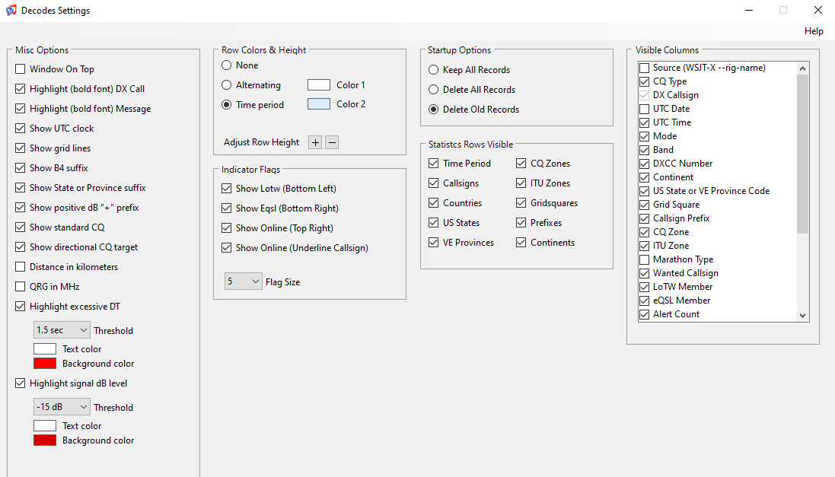
JTAlert Settings
Highlight Excessive DT
If all of the DTs you’re seeing are more than a second then YOU are the problem, not the other way around.
Highlight signal dB level
Visible Columns
Notes:
Excessive DT (Time Differential) happens when your computer clock is not synchronized with a global time server.
Setting the signal dB level threshold makes it obvious which stations are going to be harder to get a QSO from. While -24 is not unheard of, it is not the norm.
Setting the visible columns for what is most important for what screen real estate you may have.

Slide 10
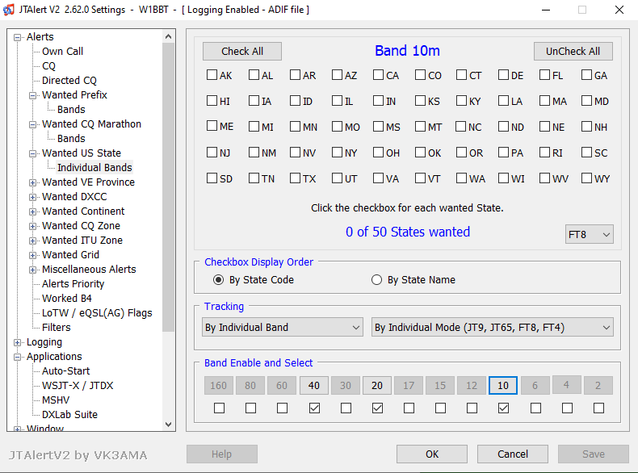
What do you want?
Looking for 50 states?
Looking for Grid Squares?
Looking for All Continents?
Tracking by mixed mode or by band/mode?

Slide 11
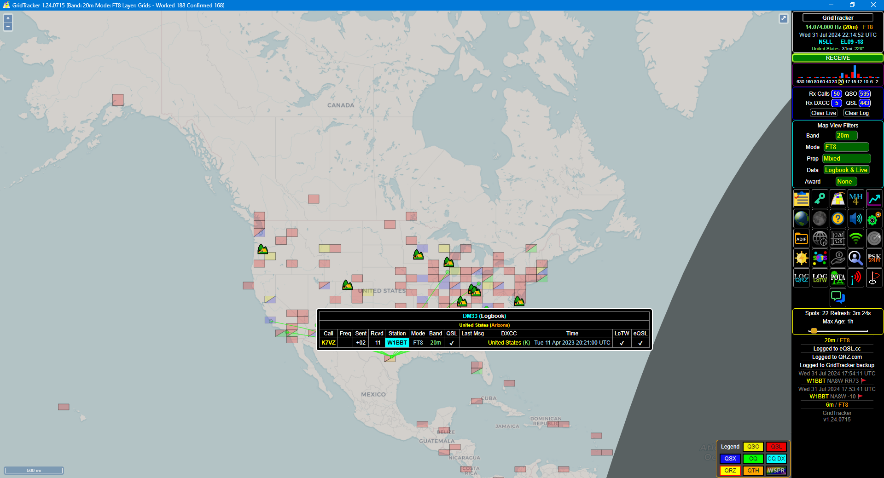
GridTracker
The workhorse of my FT8 setup, GridTracker manages verbal alerts, searching for stations not actively calling CQ, and logging in realtime to QRZ.

Slide 12
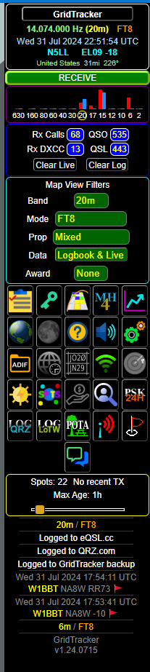
GridTracker: Controls
WSJTX Connection
Map View Filters
Too many buttons to cover them all, but:
  Grid Square
  Spot
  Log QRZ/LoTW
Spot History
Logging
Logging Backup

Slide 13
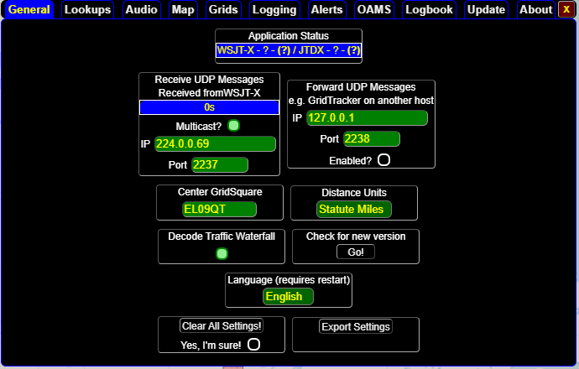
GridTracker: Settings
Connection to WSJTX
Remember that UDP Multicast Address/Port?

Slide 14
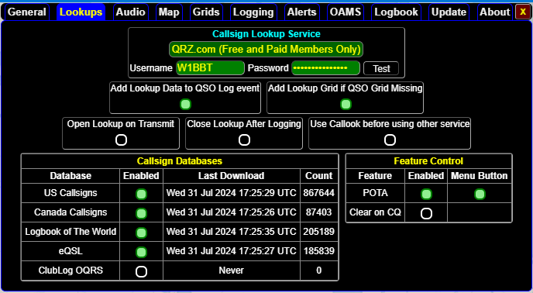
GridTracker: Lookups
Connection to QRZ
Lookups with FCC ULS
Lookups with Canada IC/ISED
Lookups using LoTW
Lookups using eQSL
POTA Sites

Slide 15
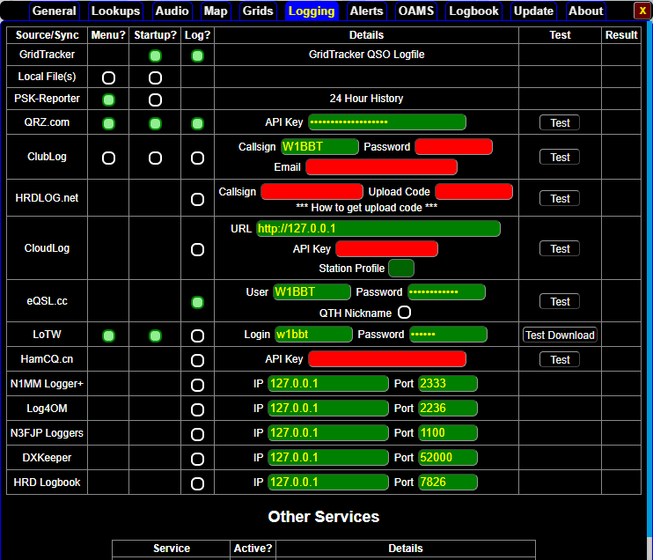
GridTracker: Logging
Backup QSO Logfile
PSK-Reporter (Disabled)
Log Synchronization
  QRZ
  ClubLog
  LoTW
  Local Loggers

Slide 16
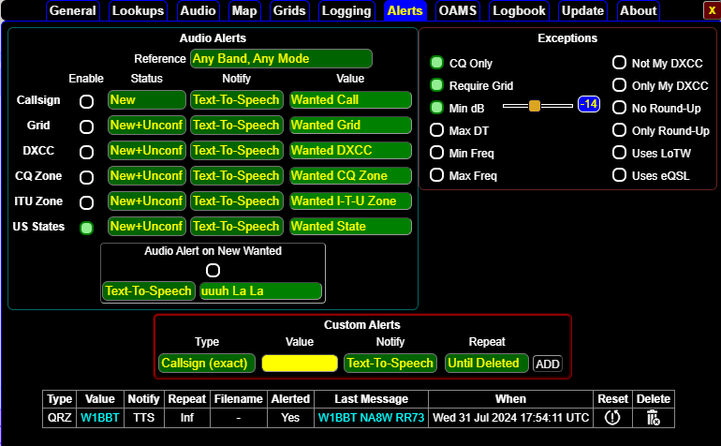
GridTracker: Alerts
Verbal “Wanted” Alerts
Filter by various values

Slide 17
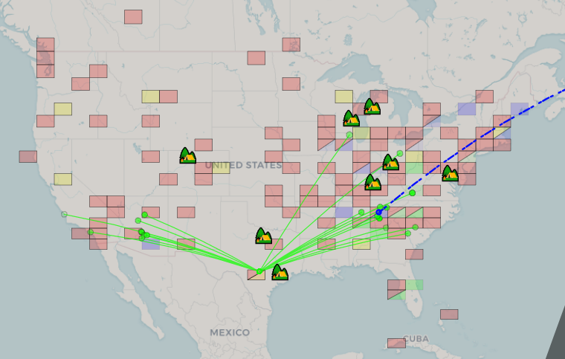
GridTracker: Map
PSK Reporting Stations that can hear you
Hover over PSK Station to get call sign
Grid Squares
  Confirmed
  Logged
POTA Sites
Current Activity

Slide 18
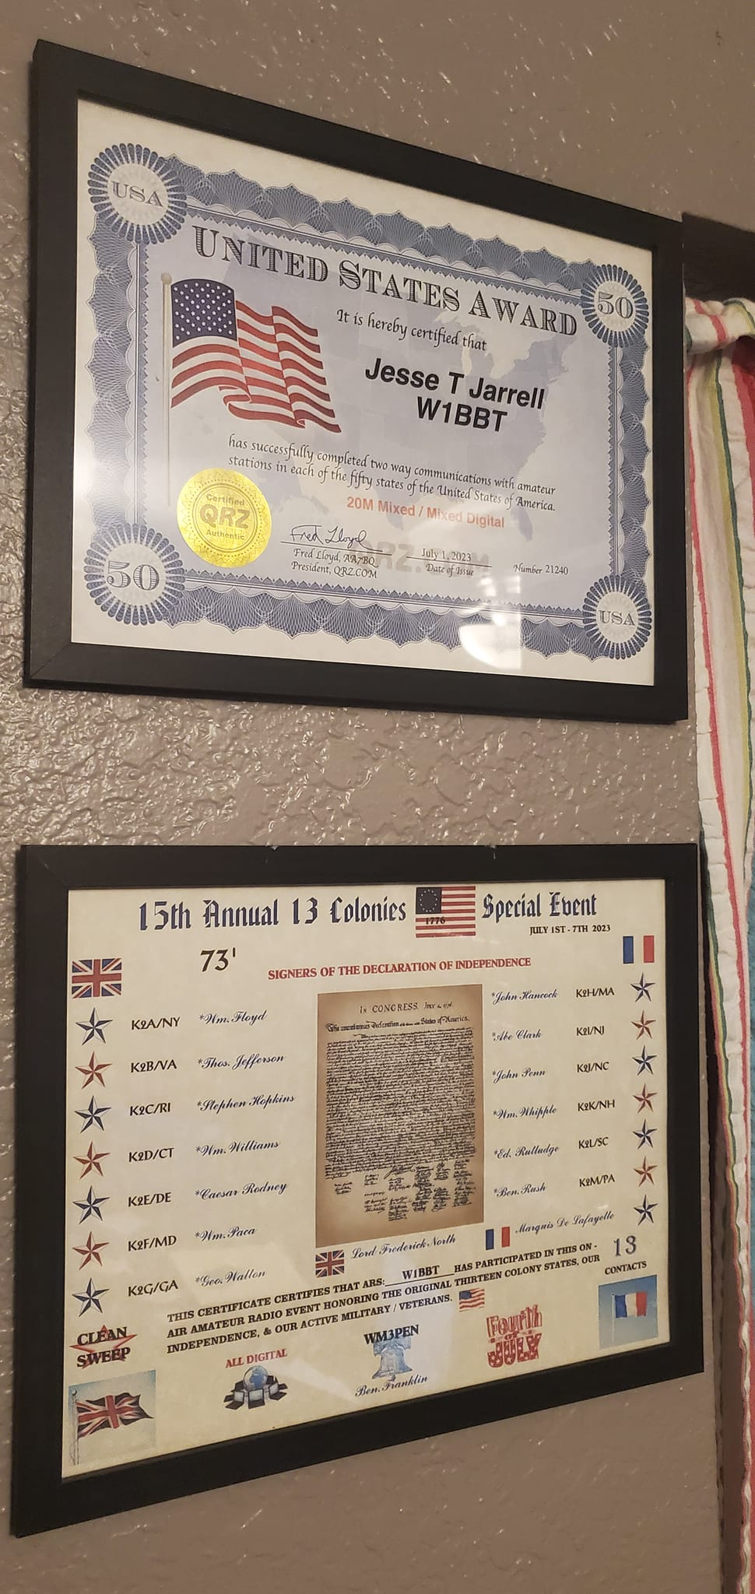
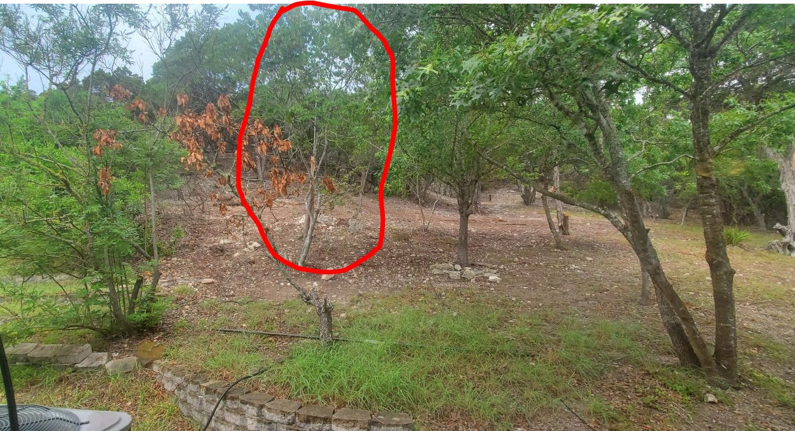
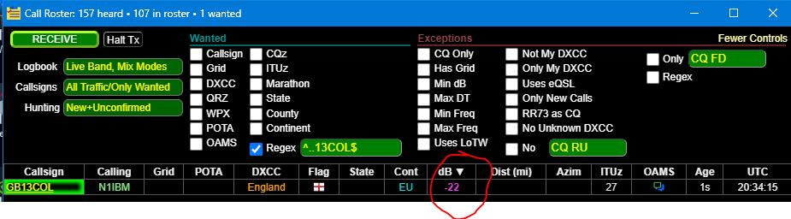
Putting It All Together
WSJTX - Decodes messages off the air
JTAlert - Visualizes live decodes
GridTracker - Makes sense of everything
All these tools work in all modes supported by WSJTX including FT8, FT4, etc.

Slide 19
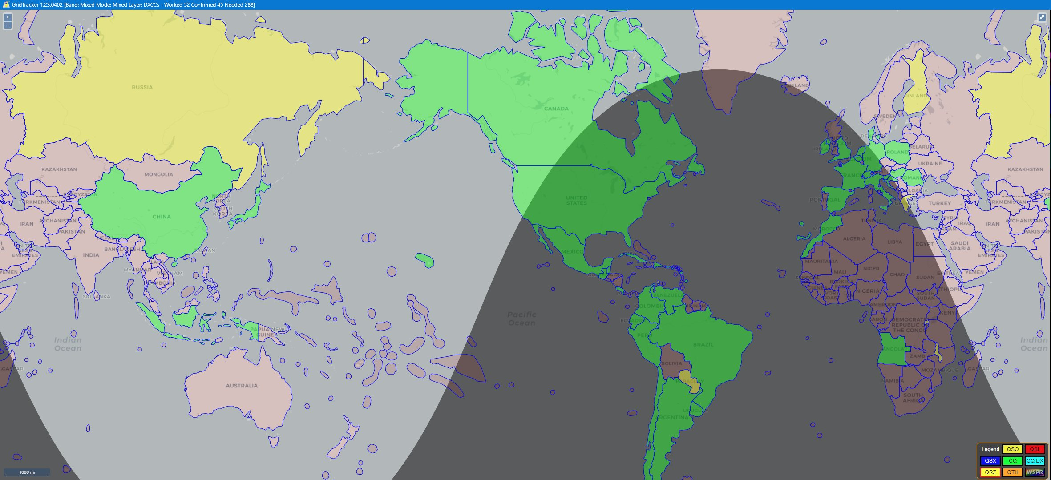
Questions?

Slide 20
Advanced WSJTX, JTAlert, GridTracker Setup
LIVE DEMO

